Slide 1


Data Analytics for Customs
WCO BACUDA Data Analytics Programme 2023 (2nd Edition)
Project Proposal:
AI-Based Risk Cargo Selectivity For Customs Fraud Detection
Team Members:
1. Santiago Tedoldi (Argentina)
2. Iqbal Ismail (Maldives)
3. Ghanpriya Balliah (Mauritius)

Slide 2
OUTLINE OF PRESENTATION
OVERVIEW
BACKGROUND
SWOT ANALYSIS
PROBLEM STATEMENT
METHODOLOGY
DEPLOYMENT STRATEGIES, TIMELINE, CHALLENGES AND SOLUTIONS
COST BENEFIT ANALYSIS
LIMITATIONS OF THE PROJECT
CONCLUSION
TYPE OF MACHINE LEARNING
DATA COLLECTION
Notes:
15 hs of training
Many categorical variables, which are time consuming

Slide 3
OVERVIEW
PROJECT OBJECTIVES
Enhance Customs fraud detection by developing an AI-based Risk Cargo Selectivity Algorithm;
Integrate a data-driven approach to the current Risk Management System (RMS);
Provide data-driven insights for proactive fraud prevention and resource allocation.
KEY CHALLENGES
Overall data quality and risk-related data availability;
Integration challenges with existing systems;
Explainability and transparency in fraud detection.
Notes:
Human intuition
Contextual understanding
Adaptability
Emotional intelligence
Hypothesis-driven approach Data-driven approach
Rule based decisions ML and AI algorithms
Business knowledge and expertise Hidden patterns

Slide 4
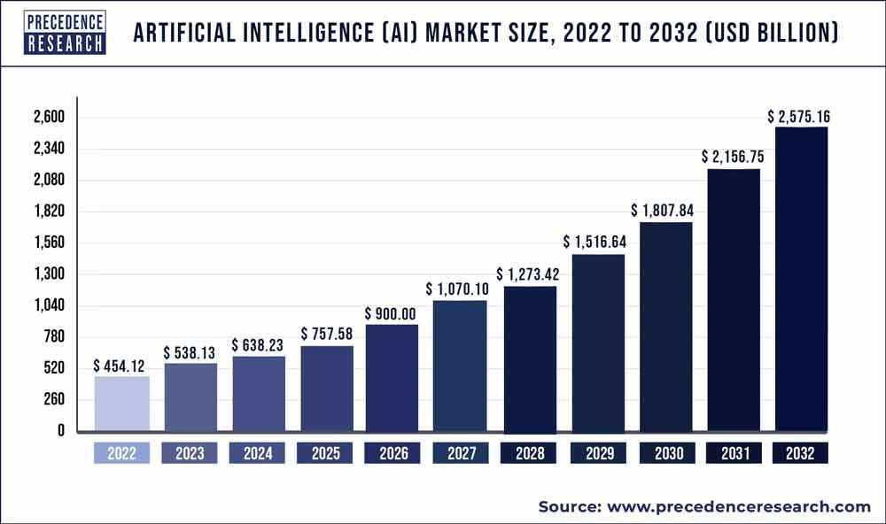
BACKGROUND
GLOBAL ARTIFICIAL INTELLIGENCE MARKET SIZE (Forecast 2023 – 2032)

Slide 5
BACKGROUND
GLOBAL PERSPECTIVE
LOCAL PERSPECTIVE
Booming international trade due to globalization and advancements in transports;
Resource constraints such as Human Resources;
Complex decision-making of Enforcement v/s. Trade Facilitation;
Struggle to implement sophisticated systems for customs processing, cargo tracking, and risk assessment;
Awareness about the Machine Learning and Artificial Intelligence potential (some regions may face challenged while others can implement).
International supply chains (complex global supply chains and vulnerable to disruptions events such as COVID-19);
Increase in trade facilitation demands and measures;
AI revolution as AI is employed to optimize supply chains, enhance logistics, and improve decision-making processes.

Slide 6
SWOT ANALYSIS
S
Global Community WCO BACUDA
W
Poor Data Quality
O
T
Innovation for a better service
Compliance improvement
Strong trade relationships
Resistance to change
Lack of political will
Technical challenges
Cost-effective and open source technologies
Data availability
Corruption
Non-innovative environment
STRENGTHS
WEAKNESSES
OPPORTUNITIES
THREATS
Economical Worth

Slide 7
PROBLEM STATEMENT
Increasing risk of Customs fraud
Valuation, classification and origin fraud
Limited resources
Loss in Revenue Collection
Smuggling
Challenging decision-making environment
Underpayment/Non-payment of duties and taxes
Prohibitions and illegal drugs
Threats to safety and security
Complex legal framework
Trade-off between enforcement and facilitation
Increasing volume trade
Highly regulated items

Slide 8

TYPE OF MACHINE LEARNING

Slide 9
DATA COLLECTION
Data used
WCO BACUDA courses synthetic data
Argentine Customs data warehouse
Customs declarations
Inspection reports
Basic operators (broker and importers) information
Avoiding sensitive information
Constraints encountered for data collection
Data sensibility and privacy issues
Target information missing (no inspection results)

Slide 10









DATA COLLECTION
(+) Overcoming some real data usage restrictions
(+) Creating data to simulate not yet encountered
conditions
SYNTHETIC DATA WITH
CTGAN
(+) Good preserving distributions and proportions
(-) Computing consuming generation
(-) Bad preserving correlations and mutual information

Slide 11
DATASET FEATURES
SYNTHETIC DATA |  |  |  | REAL DATA FROM ARGENTINA
SN | FEATURE | DESCRIPTION |  | SN | FEATURE | DESCRIPTION
1 | Year | Year of the operation |  | 1 | Officialization Date | Cargo declaration date
2 | Month | Month of the operation
3 | Day | Day of the operation
4 | Office | Custom office ID where the cargo is declared |  | 2 | Customs Office | Customs office of goods declared
5 | Importer.Tin | Importer ID; Importer registration number |  | 3 | Not Available (Data Privacy)
6 | Tariff.Code | HS classification of the goods imported |  | 4 | Tariff code | WCO Hs classification code
7 | Origin.Code | 2 digits Country code where goods originated. |  | 5 | Country of Origin | Country of origin where goods originated
8 | CIF_USD_EQUIVALENT | CIF value of the goods declared in USD |  | 6 | FOB Amount | FOB value of the goods declared in USD
9 | Quantity | Quantity declared base on HS unit |  | 7 | Statistical Quantity | Quantity declared base on HS unit
10 | GROSS.WEIGHT | Gross weight of the declared item |  | 8 | Net Weight | Net weight in KGM of the goods
11 | TOTAL.TAXES.USD | Taxes/Duties paid by the importer in USD |  | 9 | Taxes paid | Total taxes paid in USD
12 | RAISED_TAX_AMOUNT_USD | Increase of revenues due to illicit detection |  | 10 | ID | Declaration + item number makes a unique ID
13 | illicit | Indicator whether the operation was fraud or not |  | 11 | Destination type/Regime | Destination and the regime of the cargo
 |  |  |  | 12 | Quantity of Packages | Number of packages for bulk cargo
 |  |  |  | 13 | Means of Transport | Mode of transportation of the cargo
 |  |  |  | 14 | Operational location | Location of the control inspection
 |  |  |  | 15 | Merchandise use | Condition of the cargo
 |  |  |  | 16 | Country of Destination | Country of final destination
 |  |  |  | 17 | Statistical unit | Statistical unit of the Quantity
 |  |  |  | 18 | Tariff rate | Tax rate of the goods
 |  |  |  | 19 | Activity starting date of IM/EX | Activity starting date of the company
 |  |  |  | 20 | Debt indicator | Financial status of the company
 |  |  |  | 21 | Activity starting of broker | Date of the broker registration
 |  |  |  | 22 | Legal procedure indicator | Appeal procedure by the importer
 |  |  |  | 23 | Confiscation indicator | Indicates weather the goods are confiscated or not
 |  |  |  | 24 | Inspector Code | Inspector identity code
 |  |  |  | 25 | Observations | Observation by the inspection officer
 |  |  |  | 26 | Infraction code | Type of infraction
 |  |  |  | 27 | Penalty fee | Penalty fee for the illicit activity in USD

Slide 12
METHODOLOGY
Model Pipeline
Feature Engineering
Risk Profiling
Feature Selection
Models Training and Evaluation
Data Wrangling and EDA
Model Selection

Slide 13
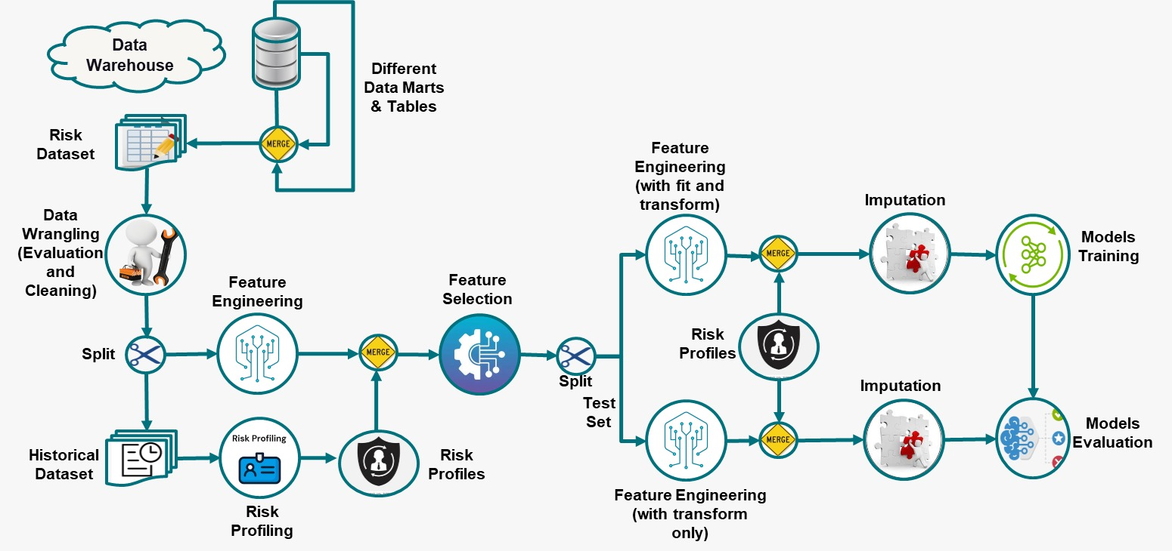
MODEL PIPELINE

Slide 14
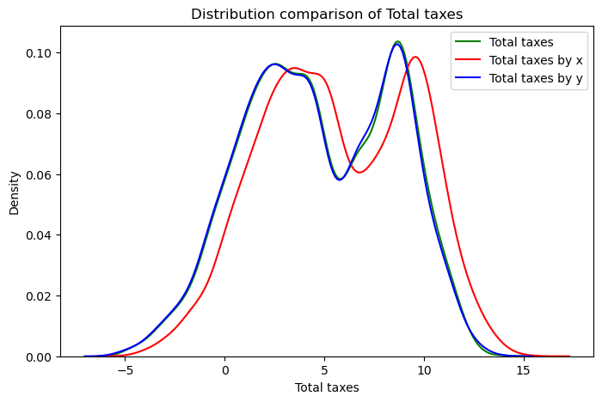
DATA WRANGLING
Missing values
Columns and rows
Duplicates
Hidden duplicates dropping categories
Duplicate column
Item FOB amount
For selection total taxes and tax rate
Simple variable selection
Import variables only
Variance
Notes:
Duplicates by DDT_item drop
Same information for different items in a declaration.
A attribute could be built from this, True when multi-item declaration and False when single-item declaration.
Duplicates by infraction type code drop
multi-type infraction, important to solve for a multiclass solution
Other duplicates like these show changes on the situation of the inspection or multiple inspectors for the same item.

Slide 15
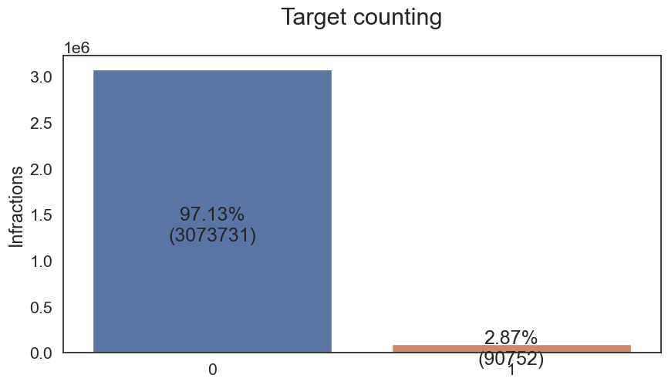
EXPLORATORY DATA ANALYSIS (EDA)
Target analysis and definition
Infraction type code
Revenue increase
Univariable analysis
Categories proportions and unique values
Numerical distribution and frequencies
Outliers detection
Log transformation
0.2% of tax rate dropped
Missing values imputation
Shadow columns
NaN with meaning
Notes:
0.2% of tax rate over 107 %

Slide 16
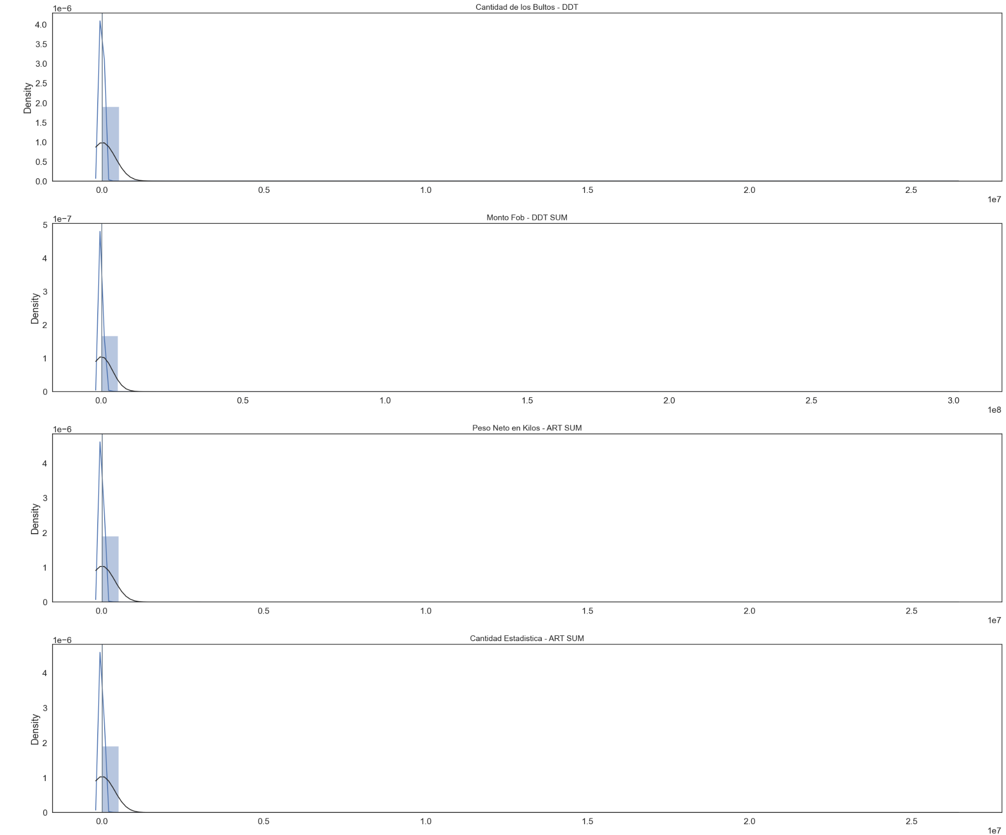
EDA

Slide 17
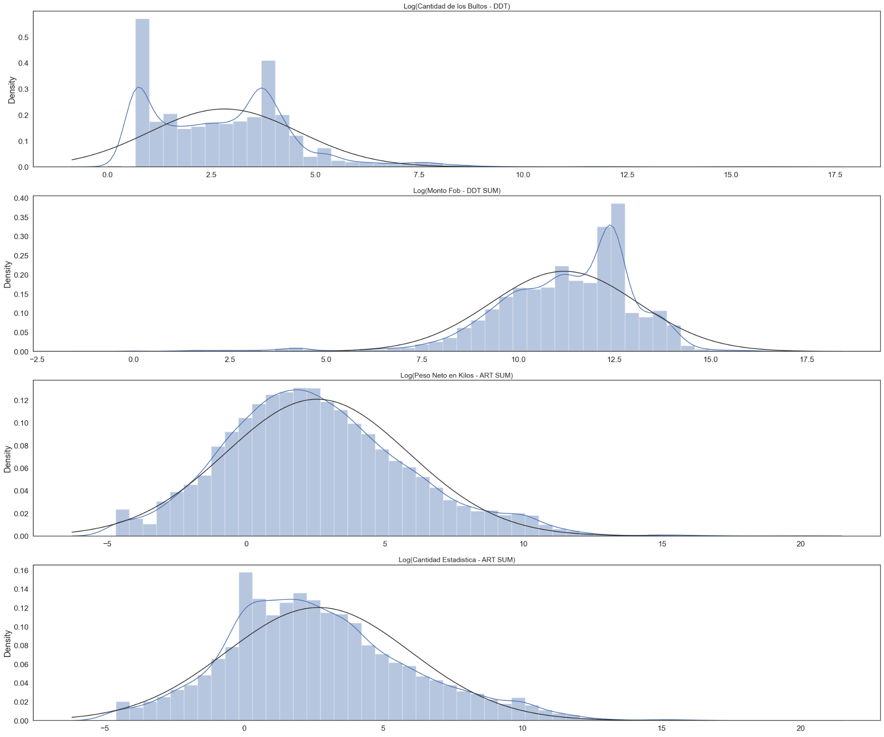
EDA

Slide 18
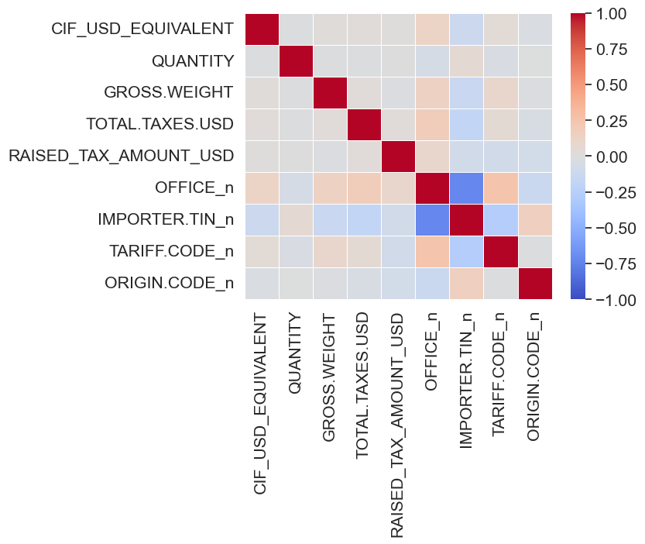
EXPLORATORY DATA ANALYSIS (EDA)
Multivariable analysis
Chi-square contingency for categories
Pair plots
Correlations
Dates and target
Notes:
Synthetic data corr

Slide 19
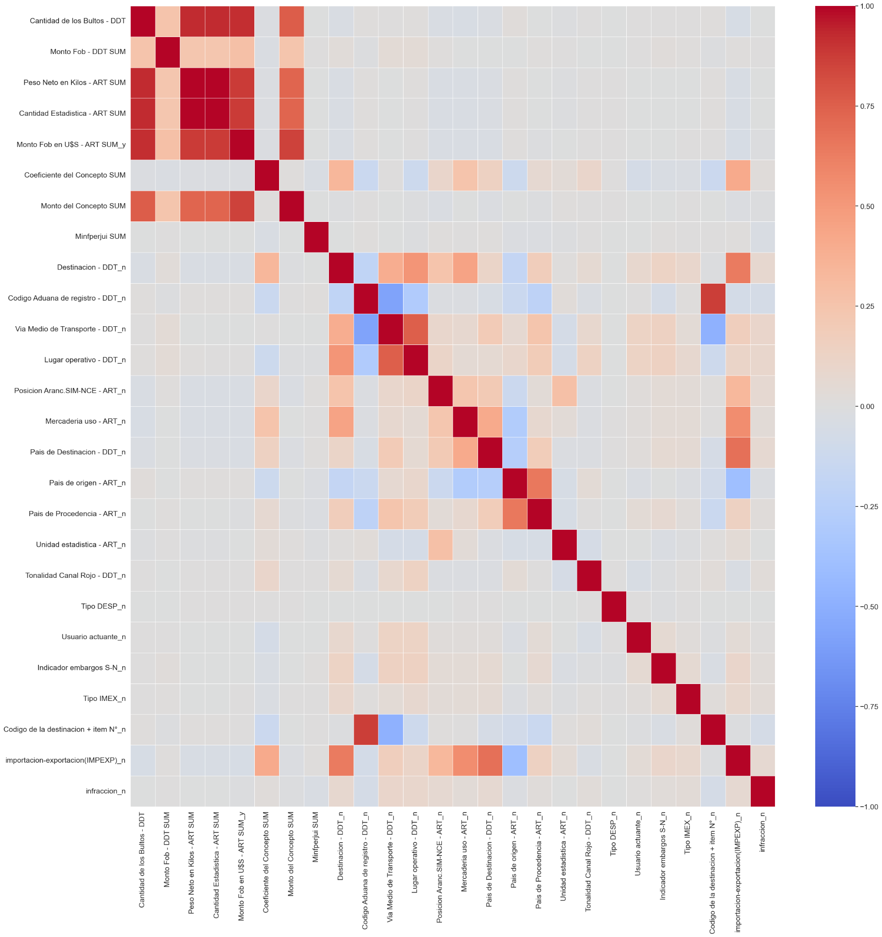
EDA
Notes:
Real data corr

Slide 20
FEATURE ENGINEERING
Creation of new features based on existing ones.
Extracting statistical information from available variables
Basic feature engineering
Origin different from precedent country
Activity level from codes
OFFICE 'Codigo Aduana de registro - DDT'
Period of activity
Months of activity of brokers and importers
Stats information and clusters from HS06 codes
One-hot-encoding
Unit price, kg per unit
ORIGIN COUNTRY 'Pais de origen - ART'
DEPARTURE COUNTRY 'Pais de Procedencia - ART
For categories with less than 15 unique values
Using unit price, kg per unit and tax rate variables
Creating the following features (from each variable):
‘HS06 activity’, '
Diff against the mean’,
‘Diff against the median’,
'Under p10’,
'Over p90’,
'Over 3Q+1.5*IQR’,
'Quartile range [0,1,2,3]’,
'Clusters’

Slide 21
RISK PROFILES
An additional split of the dataset to use codes with hundreds of unique values
Historic data
Used to apply target encoding,
Generate risk profiling tables with illicit sum, illicit rate and simple quartiles cut of them:
REGIME TYPE CODE 'Destinacion - DDT’
CUSTOMS OFFICE 'Codigo Aduana de registro - DDT’
ORIGIN COUNTRY 'Pais de origen - ART’
DEPARTURE COUNTRY 'Pais de Procedencia - ART’
And their combinations
Note: ‘IMPORTER ID’ not available for real data

Slide 22
RISK PROFILES
New data
Joined with the risk profiles tables from historic data
Processed by inputting nulls generated by the join process
Note: Data used for train, validation and test

Slide 23
FEATURE SELECTION
1° Variance Threshold
2° Mutual Information (MI)
Assess dependency between feature and target variable
(+) Continuous and discrete data
(-) Might be sensitive to noise
Simple evaluation of the variance
Removes features with 0 variance
3° Random Forest (RF) feature importance
4° Correlation Coefficient
Tree-based bagging algorithm
(+) Capture complex relationships
(+) Tends to handle noisy data well
(-) Biased against correlated variables
A. Used to group correlated variables
B. Each group was manually analyzed aiming to select the more relevant feature
Notes:
Having more around 100 variables
Ending with around 40, before one-hot enconding

Slide 24
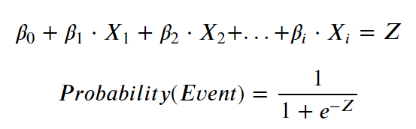
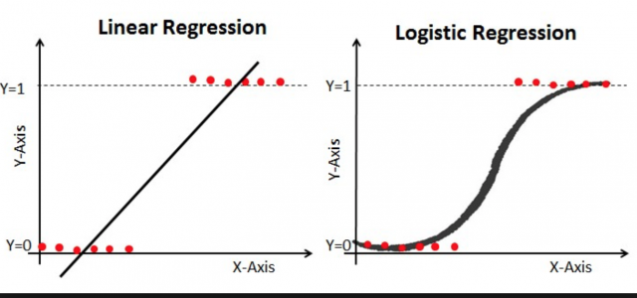
MODELS PRE-SELECTION
Logistic Regression
Linear weighted combination of variables
Sigmoid function as activation function
Assume independence among features
(+) Low computation-cost
(+) Simple and explainable
(--) Limited to capture patterns among features
Used as a base model

Slide 25
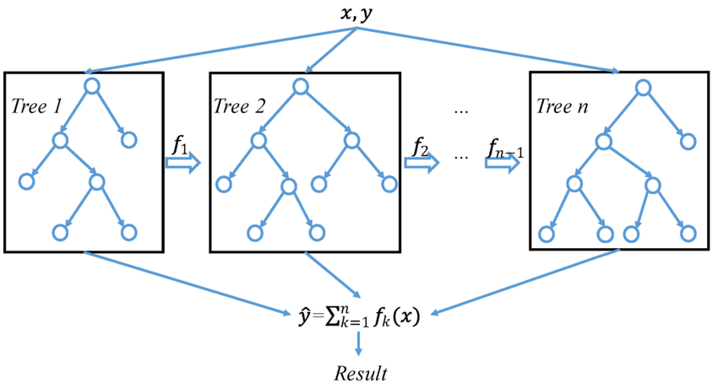
MODELS PRE-SELECTION
XGBoost
Tree-based boosting algorithm
Train several ‘weak’ trees, in sequence
The trees learn from previews trees’ errors
Used gradient descent for optimization
(+) Captures relation between features
(+) Explainable through feature importance
(-) High computation-cost
Can add complexity to our model

Slide 26
MODELS PRE-SELECTION
LightGBM
Similar architecture than XGBoost
Use Exclusive Feature Bundling (EFB) method
Use Gradient-based One-Side Sampling (GOSS) method
(+) Fast to handle huge number of features
(+) Fast to learn from big dataset
(-) Can lose predictive power compare to XGBoost
Also, can add complexity at a lower cost

Slide 27
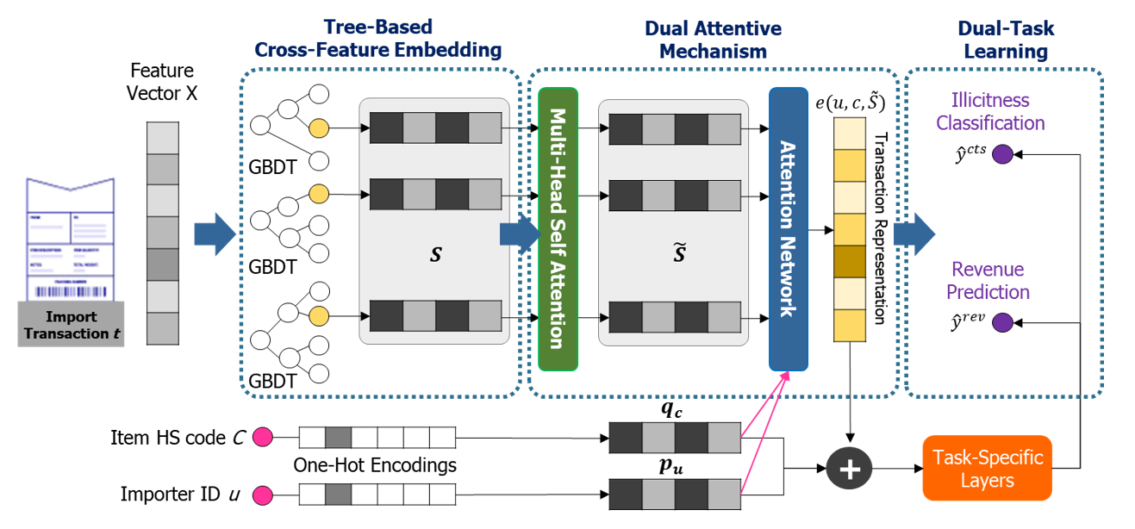
MODELS PRE-SELECTION
DATE (Dual-Attentive-Tree-Aware-Embedding)

Slide 28
TRAINING
Random Search tuning (50 iterations)
5 folds for cross-validation
Using F1 score
Balance control with hyperparameters
MODEL 1: LogisticRegression
Params = {
'penalty': ['l1', 'l2'], # Regularization penalty ('l1' or 'l2')
'C': [0.01, 0.1, 1, 10], # Inverse of regularization strength
'solver': ['liblinear', 'saga'], # Algorithm to use for optimization
'max_iter': [100, 200, 300], # iterations for optimization
'class_weight': ['balanced’]} # controls the balance
Notes:
Best estimator
LogisticRegression(C=0.1, class_weight='balanced', penalty='l1', solver='saga')

Slide 29
TRAINING
MODEL 2: LGBMClassifier
params = {
'learning_rate': [0.01, 0.05, 0.1], # step size
'n_estimators': [100, 200, 300], # number of boosting rounds or trees to build
'max_depth': [5, 7, 9], # max depth of a tree
'min_child_samples': [10, 20, 30], # min number of data points in a leaf
'subsample': [0.8, 1], # fraction of samples used for training each tree
'colsample_bytree': [0.8, 1], # fraction of features to train each tree
'reg_alpha': [0.1, 0.5, 1], # L1 reg
'reg_lambda': [0.1, 0.5, 1], # L2 reg
'scale_pos_weight': [int(len(y_train)/y_train.sum())], # controls the balance
}
Notes:
Best estimator
LGBMClassifier(colsample_bytree=0.8, learning_rate=0.01, max_depth=7, min_child_samples=30, reg_alpha=0.5, reg_lambda=1, subsample=0.8)

Slide 30
TRAINING
MODEL 2: XGBClassifier
params = {
'learning_rate': [0.01, 0.1, 0.3], # step size
'n_estimators': [50, 100], # number of trees
'max_depth': [3, 5, 7], # max depth of a tree
'min_child_weight': [3, 5], # min sum of instance weight needed in a child
'subsample': [0.8], # fraction of samples used for training each tree
'olsample_bytree': [0.8], # fraction of features to train each tree
'gamma': [1, 2], # min loss reduction to make a further partitions
'lambda': [2, 3], # L2 reg
'alpha': [5, 7], # L1 reg
'scale_pos_weight': [int(len(y_train)/y_train.sum())], # controls the balance
}
Notes:
Best estimator
XGBClassifier(alpha=7, gamma=2, lambda=3, learning_rate=0.1, max_depth=5, min_child_weight=5, n_estimators=100)

Slide 31
EVALUATION METRICS
Accuracy
Precision
Recall
F1 Score
AUC
ROC

Slide 32
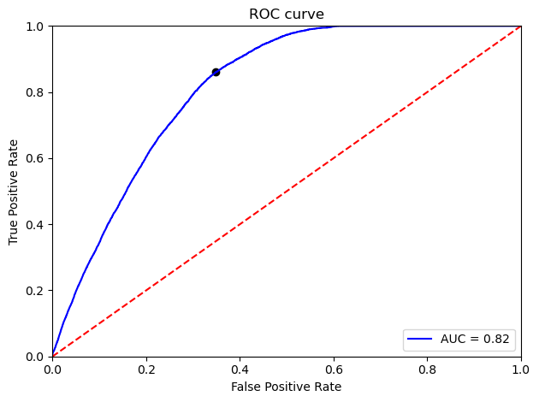
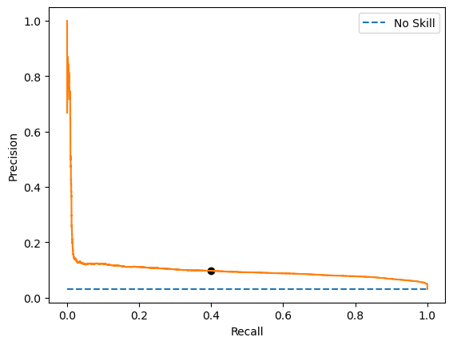
EVALUATION
LogisticRegression
# Threshold based analysis
ROC curve analysis
Model AUC: 0.8157
Best ROC Threshold value = 0.5090
# Metrics with optimal threshold
Metric | Train | Test
Accuracy | 0.658 | 0.658
Precision | 0.073 | 0.072
Recall | 0.856 | 0.86
F1 | 0.134 | 0.134

Slide 33
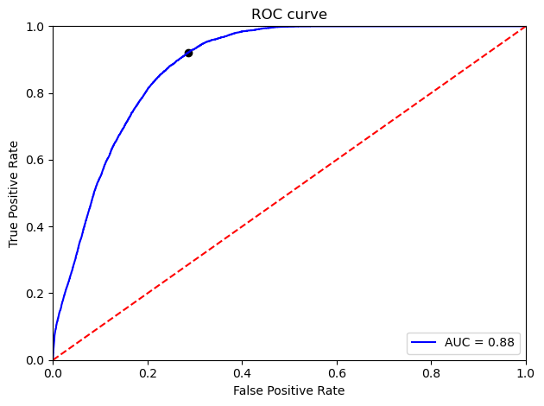
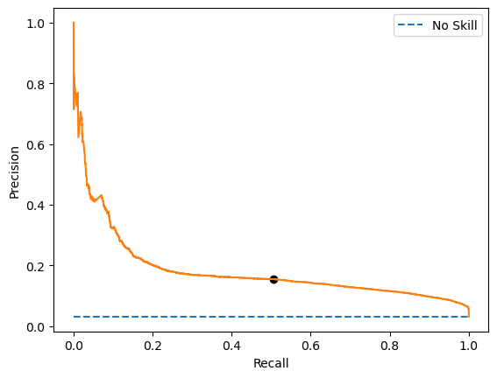
EVALUATION
LGBMClassifier
# Threshold based analysis
ROC curve analysis
Model AUC: 0.8846
Best ROC Threshold value = 0.3674
# Metrics with optimal threshold
Metric | Train | Test
Accuracy | 0.721 | 0.721
Precision | 0.094 | 0.093
Recall | 0.927 | 0.922
F1 | 0.171 | 0.168

Slide 34
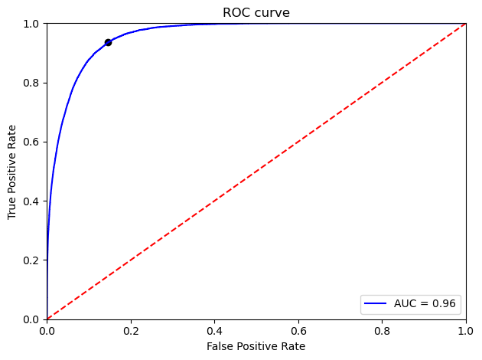
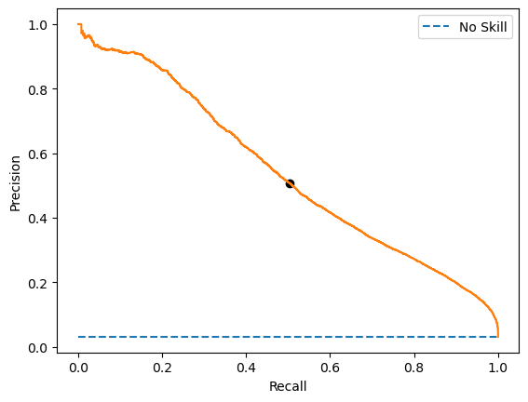
EVALUATION
XGBClassifier
# Threshold based analysis
ROC curve analysis
Model AUC: 0.9592
Best ROC Threshold value = 0.5162
# Metrics with optimal threshold
Metric | Train | Test
Accuracy | 0.86 | 0.857
Precision | 0.177 | 0.169
Recall | 0.968 | 0.936
F1 | 0.299 | 0.286

Slide 35
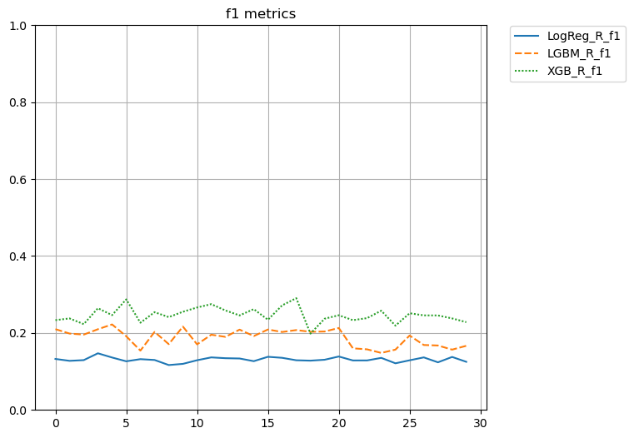
MODEL SELECTION
F1 mean with threshold by default
LogReg_R_f1 | 0.130791
LGBM_R_f1 | 0.188104
XGB_R_f1 | 0.247082

Slide 36
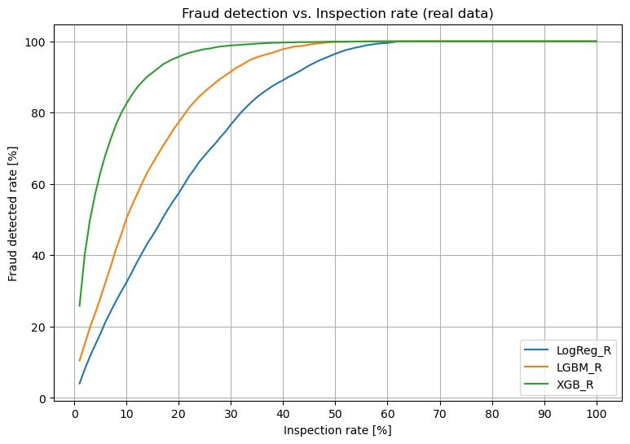
MODEL SELECTION
Notes:
| | 1 | 3 | 10 | 20 | 30 | 40 | 50 |
|:------------------------|----------:|---------:|---------:|---------:|---------:|---------:|---------:|
| detection_rate_LogReg_R | 0.0404304 | 0.116648 | 0.324236 | 0.573952 | 0.766818 | 0.890827 | 0.965006 |
| detection_rate_LGBM_R | 0.104643 | 0.197735 | 0.503964 | 0.773613 | 0.914949 | 0.978029 | 0.998188 |
| detection_rate_XGB_R | 0.257984 | 0.49966 | 0.825708 | 0.956852 | 0.988335 | 0.996602 | 0.999207 |

Slide 37
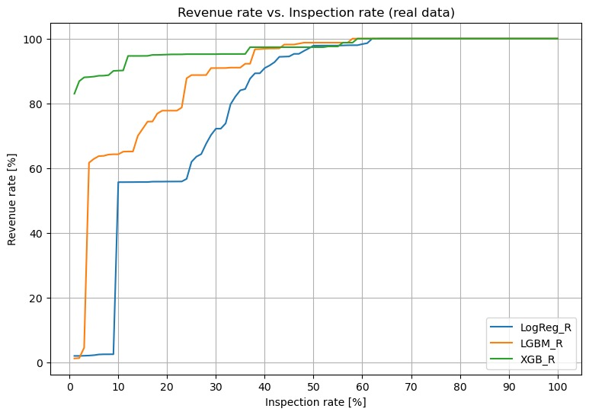
MODEL SELECTION
Notes:
| | 1 | 3 | 10 | 20 | 30 | 40 | 50 |
|:----------------------|----------:|----------:|---------:|---------:|---------:|---------:|---------:|
| revenue_rate_LogReg_R | 0.0209806 | 0.0215115 | 0.557152 | 0.558996 | 0.722183 | 0.90916 | 0.978339 |
| revenue_rate_LGBM_R | 0.0132047 | 0.0462575 | 0.643147 | 0.777763 | 0.909101 | 0.968856 | 0.987557 |
| revenue_rate_XGB_R | 0.830023 | 0.880463 | 0.90124 | 0.950827 | 0.952075 | 0.973572 | 0.973572 |

Slide 38
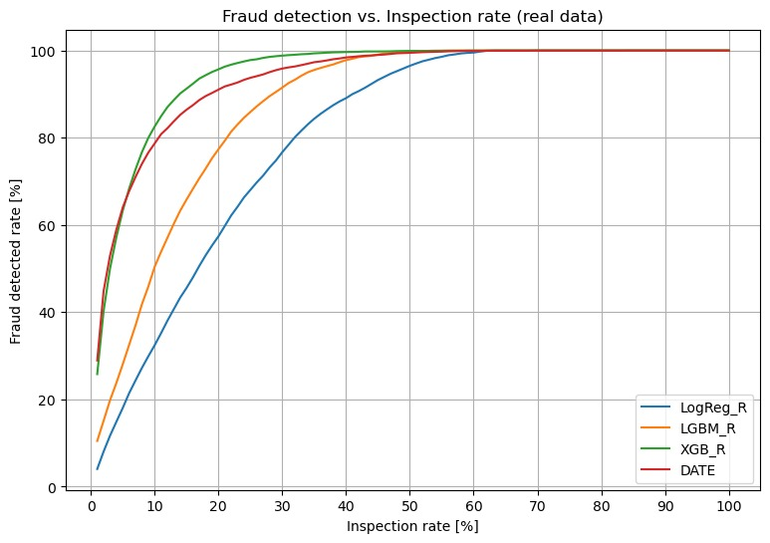
BACUDA DATE MODEL
Note: DATE model using country of ‘origin’ in place of ‘importers id’
Notes:
| | 1 | 3 | 10 | 20 | 30 | 40 | 50 |
|:------------------------|----------:|---------:|---------:|---------:|---------:|---------:|---------:|
| detection_rate_DATE | 0.293621 | 0.538365 | 0.798922 | 0.927403 | 0.96496 | 0.981312 | 0.992453 |
| detection_rate_LogReg_R | 0.0404304 | 0.116648 | 0.324236 | 0.573952 | 0.766818 | 0.890827 | 0.965006 |
| detection_rate_LGBM_R | 0.104643 | 0.197735 | 0.503964 | 0.773613 | 0.914949 | 0.978029 | 0.998188 |
| detection_rate_XGB_R | 0.257984 | 0.49966 | 0.825708 | 0.956852 | 0.988335 | 0.996602 | 0.999207 |

Slide 39
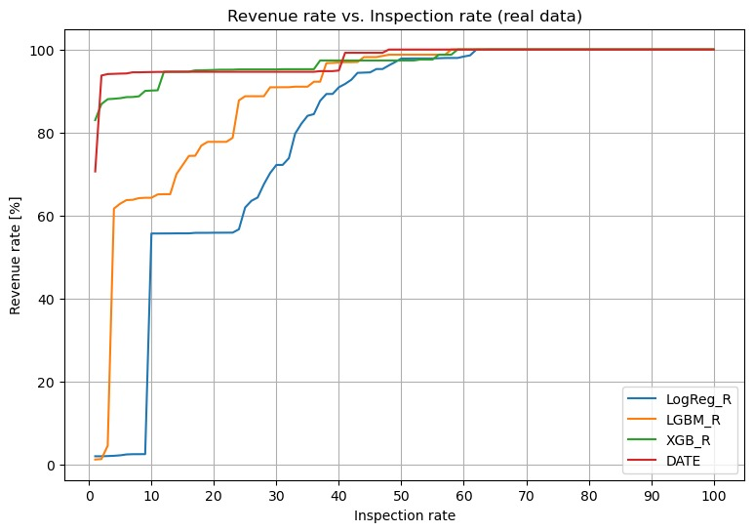
BACUDA DATE MODEL
Note: DATE model using country of ‘origin’ in place of ‘importers id’
Notes:
| | 1 | 3 | 10 | 20 | 30 | 40 | 50 |
|:----------------------|----------:|----------:|---------:|---------:|---------:|---------:|---------:|
| revenue_rate_DATE | 0.862451 | 0.866054 | 0.87573 | 0.947909 | 0.998402 | 1 | 1 |
| revenue_rate_LogReg_R | 0.0209806 | 0.0215115 | 0.557152 | 0.558996 | 0.722183 | 0.90916 | 0.978339 |
| revenue_rate_LGBM_R | 0.0132047 | 0.0462575 | 0.643147 | 0.777763 | 0.909101 | 0.968856 | 0.987557 |
| revenue_rate_XGB_R | 0.830023 | 0.880463 | 0.90124 | 0.950827 | 0.952075 | 0.973572 | 0.973572 |

Slide 40
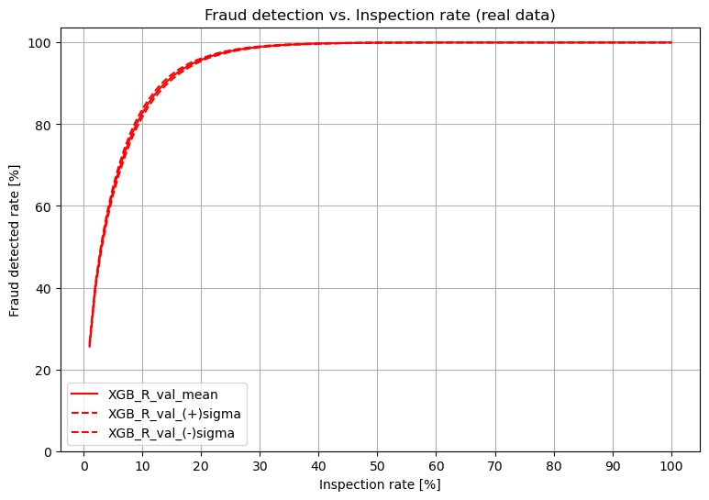
MODEL VALIDATION
Notes:
| | 1 | 3 | 10 | 20 | 30 | 40 | 50 |
|:------------------------|----------:|---------:|---------:|---------:|---------:|---------:|---------:|
| detection_rate_LogReg_R | 0.0404304 | 0.116648 | 0.324236 | 0.573952 | 0.766818 | 0.890827 | 0.965006 |
| detection_rate_LGBM_R | 0.104643 | 0.197735 | 0.503964 | 0.773613 | 0.914949 | 0.978029 | 0.998188 |
| detection_rate_XGB_R | 0.257984 | 0.49966 | 0.825708 | 0.956852 | 0.988335 | 0.996602 | 0.999207 |

Slide 41
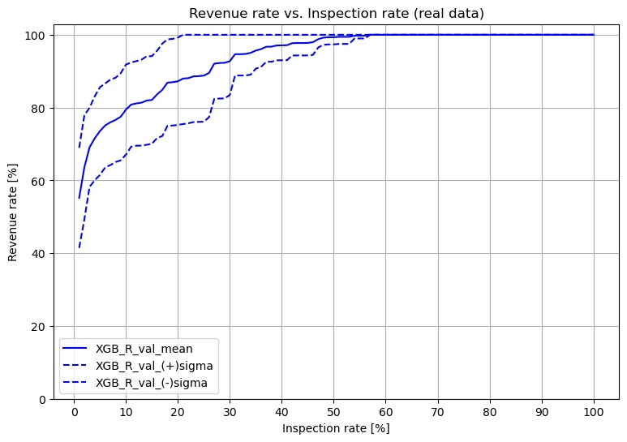
MODEL VALIDATION
Notes:
| | 1 | 3 | 10 | 20 | 30 | 40 | 50 |
|:------------------------|----------:|---------:|---------:|---------:|---------:|---------:|---------:|
| detection_rate_LogReg_R | 0.0404304 | 0.116648 | 0.324236 | 0.573952 | 0.766818 | 0.890827 | 0.965006 |
| detection_rate_LGBM_R | 0.104643 | 0.197735 | 0.503964 | 0.773613 | 0.914949 | 0.978029 | 0.998188 |
| detection_rate_XGB_R | 0.257984 | 0.49966 | 0.825708 | 0.956852 | 0.988335 | 0.996602 | 0.999207 |

Slide 42
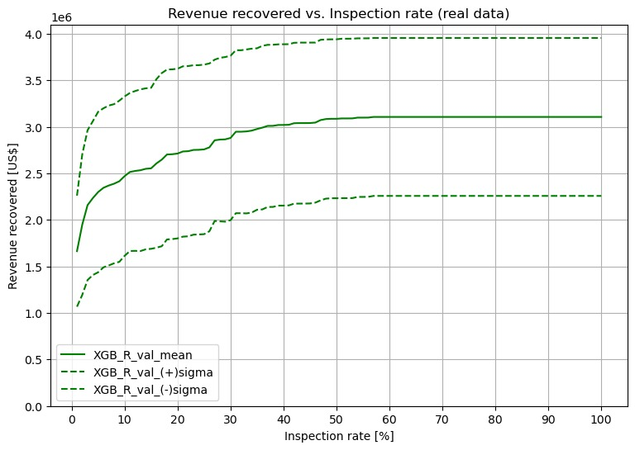
MODEL VALIDATION
Notes:
| | 1 | 3 | 10 | 20 | 30 | 40 | 50 |
|:------------------------|----------:|---------:|---------:|---------:|---------:|---------:|---------:|
| detection_rate_LogReg_R | 0.0404304 | 0.116648 | 0.324236 | 0.573952 | 0.766818 | 0.890827 | 0.965006 |
| detection_rate_LGBM_R | 0.104643 | 0.197735 | 0.503964 | 0.773613 | 0.914949 | 0.978029 | 0.998188 |
| detection_rate_XGB_R | 0.257984 | 0.49966 | 0.825708 | 0.956852 | 0.988335 | 0.996602 | 0.999207 |

Slide 43
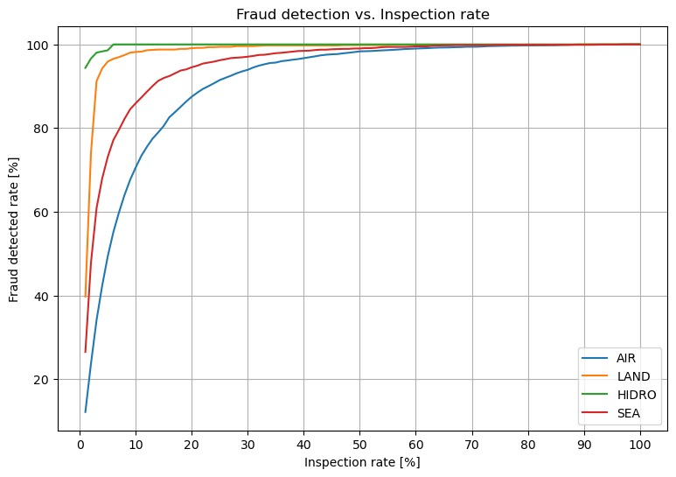
PROBLEM SPLITTING
XGBClassifier trained regarding
means of transport
Concatenated results
Metric | Test
Accuracy | 0.95
Precision | 0.369
Recall | 0.879
F1 | 0.52
Notes:
| | 1 | 3 | 10 | 20 | 30 | 40 | 50 |
|:-------------------------|---------:|---------:|---------:|---------:|---------:|---------:|---------:|
| detection_rate_XGB_air | 0.121598 | 0.3411 | 0.706285 | 0.875073 | 0.939299 | 0.967104 | 0.983356 |
| detection_rate_XGB_land | 0.397373 | 0.912151 | 0.981938 | 0.990969 | 0.995895 | 0.997537 | 0.998358 |
| detection_rate_XGB_hidro | 0.94382 | 0.980337 | 1 | 1 | 1 | 1 | 1 |
| detection_rate_XGB_sea | 0.265049 | 0.608959 | 0.859543 | 0.945404 | 0.970602 | 0.984601 | 0.990201 |

Slide 44
DEPLOYMENT STRATEGIES
Model will be deployed in 3 stages:
Stage 1 –
Shadow Deployment
Stage 2 –
Canary Deployment
Stage 3 –
AI-RMS Final Integration (Blue/Green Deployment)
- Model deployed in parallel
- No without effect on the
selectivity results
- Performance measure and
further analysis.
- 10% of import declarations
exposed to the model
- Impact and measuring
performance
- Definition of integration
with RMS.
- Model integrated with
RMS
- Reduction of targeted
physical inspection
achieved
- Model monitoring,
continuous improvement
and re-training
Overall Strategy Highlights:
Risk management performance preserved with gradual integration.
Continuous monitoring of key metrics ensures the robustness of the AI model.
Ensuring careful analysis and evaluation at each stage.

Slide 45
DEPLOYMENT TIMELINE
2024
2025
2026
2026
Today
Phase 1:
Planning and Data Preparation
Project Definition, Data Collection and Cleaning, Exploratory Data Analysis
Mar 1
Oct 24
Phase 2:
Model Development
Feature Engineering, Model Selection, Training, Validation and Evaluation Metrics
Oct 25
170 days
Apr 10
Phase 3: Implementation
Integration with Existing Systems, Testing and User Training
2024
120 days
Apr 11
Sep 25
120 days
Phase 4: Deployment and Monitoring
Initial Deployment, Continuous Monitoring and Improvement
Sep 26
120 days
Mar 12
Phase 5: Evaluation and Optimization
Performance Review and Optimization
120 days
Mar 13
Aug 27
NOTE: This is just a proposal. It can be adjusted according to needs and requirements

Slide 46
DEPLOYMENT CHALLENGES AND SOLUTIONS
Data Privacy and Security:
Ensuring privacy and security if external servers are used
Implement robust security measures.
Monitoring and Maintenance:
Continuous monitoring and maintenance for ongoing model performance.
Design and implement monitoring tools.
Establish a regular maintenance schedule for model updates and retraining.
Human-in-the-Loop Considerations:
Promoting Human-AI collaboration.
Implement mechanisms for human-in-the-loop interventions.
Establish feedback loops for continuous improvement.
Design user interfaces for easy model intervention when necessary.
Encrypt sensitive data.
Adhere to relevant compliance standards.
Set up alerts for deviations.
Inspector Training on data quality, use and interpretation of the model.

Slide 47
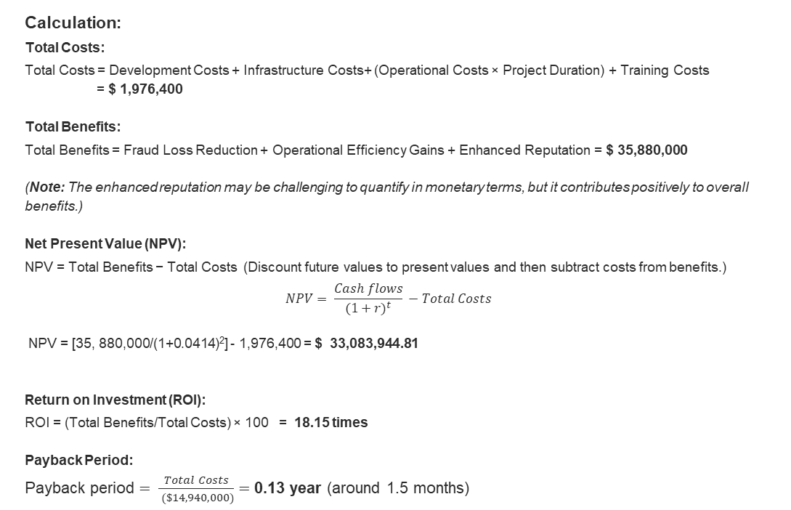
COST BENEFIT ANALYSIS
Calculation:
Total Costs:
Total Costs = Development Costs + Infrastructure Costs+ (Operational Costs × Project Duration) + Training Costs
= $ 1,976,400
Total Benefits:
Total Benefits = Fraud Loss Reduction + Operational Efficiency Gains + Enhanced Reputation = $ 35,880,000
(Note: The enhanced reputation may be challenging to quantify in monetary terms, but it contributes positively to overall benefits.)
Net Present Value (NPV):
NPV = Total Benefits − Total Costs (Discount future values to present values and then subtract costs from benefits.)
$$NPV= \frac{Cash flows}{{(1+r)}^{t}} −Total Costs$$
NPV = [35, 880,000/(1+0.0414)²] - 1,976,400 = $ 33,083,944.81
Return on Investment (ROI):
ROI = (Total Benefits/Total Costs) × 100 = 18.15 times
Payback Period:
Payback period $= \frac{Total Costs}{ (\$14,940,000)}=$0.13 year (around 1.5 months)
APPROXIMATE COSTS
DEVELOPMENT COSTS | $ 936, 000
INFRASTRUCTURE COSTS (ONE-TIME INVESTMENT) | $ 10, 400
OPERATIONAL COST (ESTIMATION) | $ 1, 000, 000
TRAINING COSTS | $ 30, 000
FRAUD LOSS REDUCTION (ESTIMATION) | $ 29,880,000
OPERATIONAL EFFICIENCY GAINS/YEAR | $ 6, 000, 000

Slide 48
LIMITATIONS OF PROJECT
Multiclass Fraud Detection
Class Imbalance: few fraud cases for some infraction types.
Legal and Ethical Concerns
Legal Implications: No legal or regulatory changes were consider so far.
Dynamic Nature of Fraud Patterns
Costs and Resource Requirements
Seasonal Variations: Fraud patterns may vary seasonally or due to external factors, and the model is not account for such variations.
Skill Intensive: Personnel knowledgeable in Data Analytics are required or external staff should be recruited.
Cost of False Positives: The cost of investigating and resolving false positives may be high, impacting the overall cost-effectiveness of the model.
Interpretation of the infraction types during the data entry of a inspection result.
Privacy Issues: The use of AI in cargo inspection raises serious privacy concerns, if external servers are used in the deployment stages.

Slide 49
CONCLUSION
Data
Synthetic data shown to be un-useful for performing model comparison and selection
CTGAN seems to produce synthetic data without preserving relations between variables
It was possible to obtain promising fraud detection results ignoring importer and broker IDs
Models
Ensemble models (XGBoost and LightGBM) shown to able to learn from real data
XGBoost was selected from the classic ML models, showing a superior mean F1 in validation stage
XGBoost selection was confirmed with Fraud detection and Revenue increase vs. Inspection rate
DATE model, using country IDs instead of importer IDs, shown similar results to XGBoost
Splitting the problem by means of transport showed significant improvement (+ 25% in F1 score)
Results and outcomes
20 % of inspection rate would result in 96 % of the fraud detected
30 % of inspection rate can would result in 99 % of the fraud detected
Intensive validation over XGBoost shows stable prediction regarding fraud detected rate
Revenue increase depends on the data and its split
Development and Deployment
It is expected that the development of this project takes around 22 months
Its deployment would require around 3 months and a continuous effort in its maintenance is advisable.

Slide 50
Thank you!

Slide 51

Questions

Slide 52
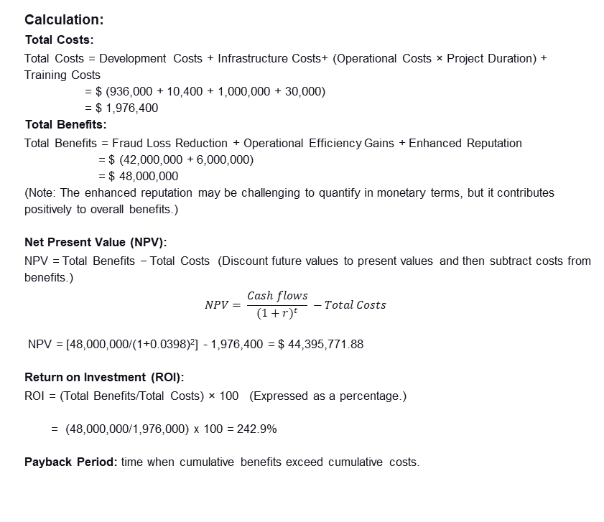
COST BENEFIT ANALYSIS
Calculation:
Total Costs:
Total Costs = Development Costs + Infrastructure Costs+ (Operational Costs × Project Duration) + Training Costs
= $ (936,000 + 10,400 + 1,000,000 + 30,000)
= $ 1,976,400
Total Benefits:
Total Benefits = Fraud Loss Reduction + Operational Efficiency Gains + Enhanced Reputation
= $ (42,000,000 + 6,000,000)
= $ 48,000,000
(Note: The enhanced reputation may be challenging to quantify in monetary terms, but it contributes positively to overall benefits.)
Net Present Value (NPV):
NPV = Total Benefits − Total Costs (Discount future values to present values and then subtract costs from benefits.)
$$NPV= \frac{Cash flows}{{(1+r)}^{t}} −Total Costs$$
NPV = [48,000,000/(1+0.0398)²] - 1,976,400 = $ 44,395,771.88
Return on Investment (ROI):
ROI = (Total Benefits/Total Costs) × 100 (Expressed as a percentage.)
= (48,000,000/1,976,000) x 100 = 242.9%
Payback Period: time when cumulative benefits exceed cumulative costs.
APPROXIMATE COSTS
DEVELOPMENT COSTS | MONTHLY SALARY | QTY | DURATION/ MTHS | TOTAL
Data Scientist | $ 6,500 | 2 | 24 | $ 312,000
Software developer/Engineer | $ 6,500 | 2 | 24 | $ 312,000
System administrators | $ 6,500 | 2 | 24 | $ 312,000
 |  |  |  | $ 936, 000
INFRASTRUCTURE COSTS (ONE-TIME INVESTMENT) | COST | QTY | DURATION/ YR | TOTAL
GPU | $ 6,800 | 1 | 1 | $ 6,800
Notebooks | $ 1,800 | 2 | 1 | $ 3,600
 |  |  |  | $ 10, 400
OPERATIONAL COST (ESTIMATION) | YEARLY | QTY | DURATION/ YR | TOTAL
Ongoing maintenance, updates, and system monitoring. | $ 500,000 | 1 | 2 | $ 1,000,000
TRAINING COSTS | COST | QTY | DURATION/YR | TOTAL
Training of personnel | $ 30,000 | 1 | 1 | $ 30,000
FRAUD LOSS REDUCTION (ESTIMATION) | COST | QTY | DURATION/YR | TOTAL
Potential reduction in financial losses due to improved fraud detection. | $ 21,000,000 | 1 | 2 | $ 42,000,000
OPERATIONAL EFFICIENCY GAINS/YEAR | COST | QTY | DURATION/YR | TOTAL
Time and resource savings through streamlined customs processes. | $ 3,000,000 | 1 | 2 | $ 6,000,000

Slide 53
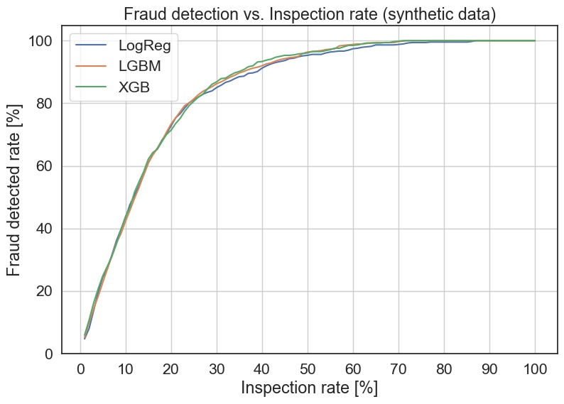
MODEL SELECTION
Notes:
| | 1 | 3 | 10 | 20 | 30 | 40 | 50 |
|:----------------------|----------:|----------:|---------:|---------:|---------:|---------:|---------:|
| revenue_rate_LogReg_R | 0.0209806 | 0.0215115 | 0.557152 | 0.558996 | 0.722183 | 0.90916 | 0.978339 |
| revenue_rate_LGBM_R | 0.0132047 | 0.0462575 | 0.643147 | 0.777763 | 0.909101 | 0.968856 | 0.987557 |
| revenue_rate_XGB_R | 0.830023 | 0.880463 | 0.90124 | 0.950827 | 0.952075 | 0.973572 | 0.973572 |

Slide 54
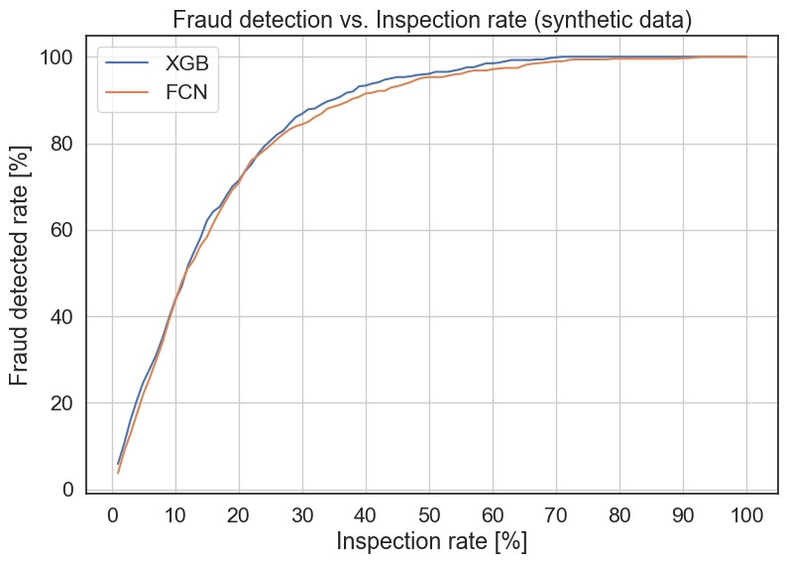
MODEL SELECTION
Notes:
| | 1 | 3 | 10 | 20 | 30 | 40 | 50 |
|:----------------------|----------:|----------:|---------:|---------:|---------:|---------:|---------:|
| revenue_rate_LogReg_R | 0.0209806 | 0.0215115 | 0.557152 | 0.558996 | 0.722183 | 0.90916 | 0.978339 |
| revenue_rate_LGBM_R | 0.0132047 | 0.0462575 | 0.643147 | 0.777763 | 0.909101 | 0.968856 | 0.987557 |
| revenue_rate_XGB_R | 0.830023 | 0.880463 | 0.90124 | 0.950827 | 0.952075 | 0.973572 | 0.973572 |

